Slide 1

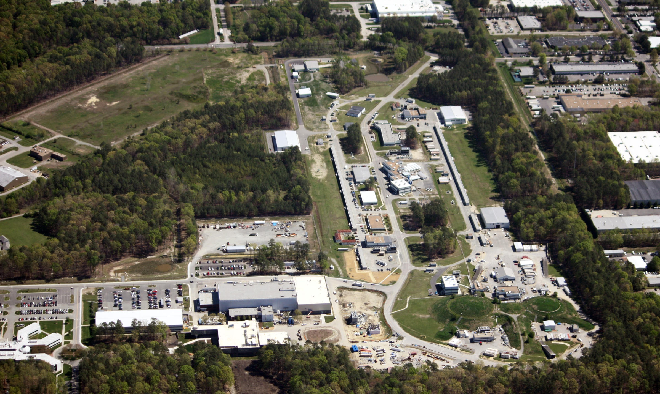
Jefferson Lab Status and Outlook
Hugh Montgomery
Jefferson Lab Users Meeting, 2012
June 4, 2012

Slide 2
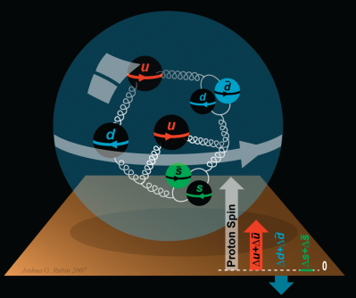


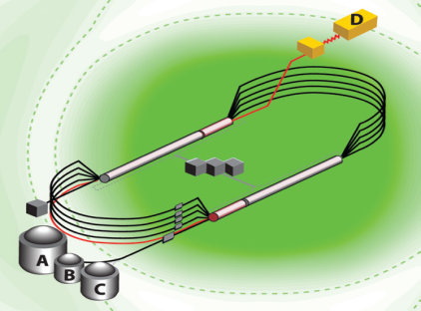
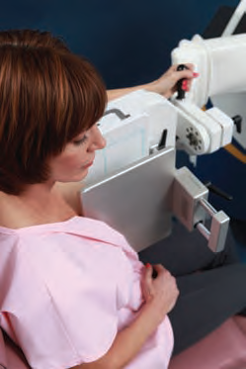
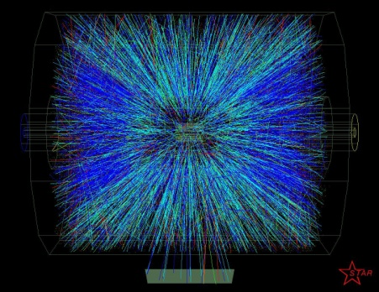


A Laboratory for Nuclear Science
Structure of Hadrons
Nuclear Structure
Fundamental
Forces & Symmetries
Accelerator S&T
Medical Imaging
Quark Confinement
Hadrons from QGP
Theory and Computation

Slide 3
Jefferson Lab Safety History
Common Causes
Newer employees are at risk
Work planning not recognizing obvious hazards/ over-reliance on experience
Workers in a hurry/ last evolution of job
Actions Taken
Re-educate all employees and users with revised ES&H Orientation
Lab Director-led meeting with all supervisors to emphasize pre-job briefing/ walk down of work site, & Safety Observations by supervisors
Introduced Human Performance as a safety management tool
Conducted All-Hands Meeting to reinforce work planning prior long shutdown
Actions Planned
Safety Culture Survey and Predictive Analysis Efforts (Summer 2012)
  ES&H Directors’ Meeting at JLab has informed this effort

Slide 4
Jefferson Lab At-A-Glance
Created to build and Operate the Continuous Electron Beam Accelerator Facility (CEBAF), world-unique user facility for Nuclear Physics: Mission is to gain a deeper understanding of the structure of matter Through advances in fundamental research in nuclear physics Through advances in accelerator science and technology In operation since 1995 1,376 Active Users 178 Completed Experiments to-date Produces ~1/3 of US PhDs in Nuclear Physics (406 PhDs granted, 180 more in progress) Managed for DOE by Jefferson Science Associates, LLC (JSA) Human Capital: 769 FTEs 22 Joint faculty; 27 Post docs; 14 Undergraduate, 33 Graduate students K-12 Science Education program serves as national model Site is 169 Acres, and includes: 83 SC Buildings & Trailers; 749K SF Replacement Plant Value: $331M
FY 2011:
Total Lab Operating Costs: $185M
Non-DOE Costs: $13M

Slide 5
ONP Funding FY2009 to FY2013
Funding | FY09 Appropriation | FY10 Appropriation | FY11 Appropriation | FY2012 Appropriation Reallocated | FY2013 Guidance Reallocated | Summary Comments
Accelerator Operations | 47,120 | 46,080 | 43,976 | 44,130 | 41,896
SRF R&D | 1,935 | 1,365 | 2,421 | 2,100 | 2,100
Accelerator Facility Capital | 130 | 200 | 200 | 0 | 0
Accelerator Improvement Projects | 650 | 1,050 | 1,050 | 622 | 2,600
Experimental Facility Operations | 24,559 | 25,967 | 27,150 | 27,720 | 25,000
Experimental Facility Capital | 4,500 | 6,605 | 5,250 | 100 | 3,300
GPP | 1,800 | 2,000 | 2,516 | 2,000 | 2,500
Subtotal NP Facility Ops | 80,694 | 83,267 | 82,563 | 76,672 | 77,396
ME Research | 6,150 | 6,200 | 6,495 | 6,550 | 6,600
Theory Research | 3,400 | 3,699 | 4,000 | 3,900 | 4,000
Subtotal NP Base | 90,244 | 93,166 | 93,058 | 87,122 | 87,996
12 GeV | 28,623 | 20,000 | 35,928 | 50,000 | 43,072
Total NP Base and 12 GeV | 118,867 | 113,166 | 128,986 | 137,122 | 131,068

Slide 6
Strategic Plan Status
Held town meetings with Physics, Theory, Accelerator, FEL divisions
Also held one for “Technology Development and Technical Infrastructure” – cryo, accelerator R&D, detector development, etc.
Open town meeting with users March 16
Lab leadership retreat in Summer 2012
JSA Science Council: Recommend broader scope

Slide 7
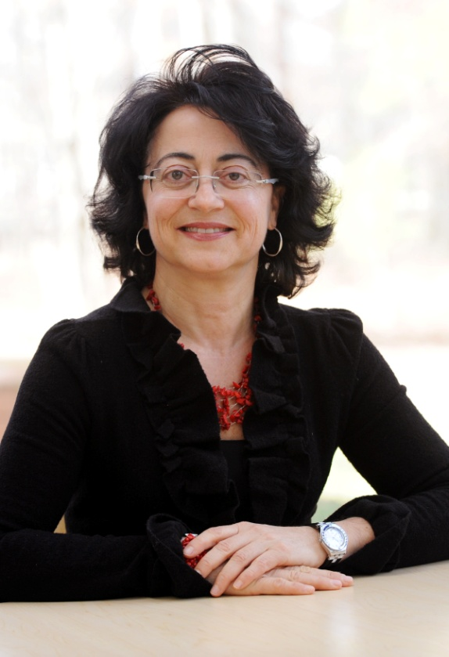
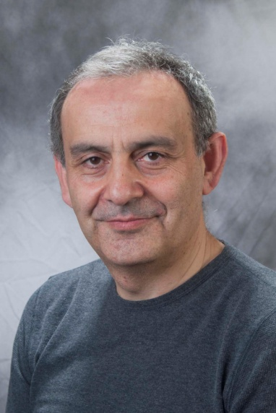
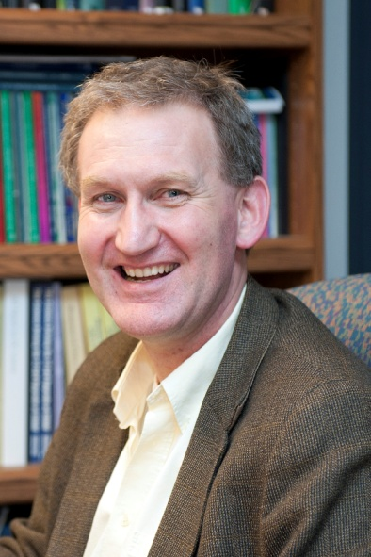
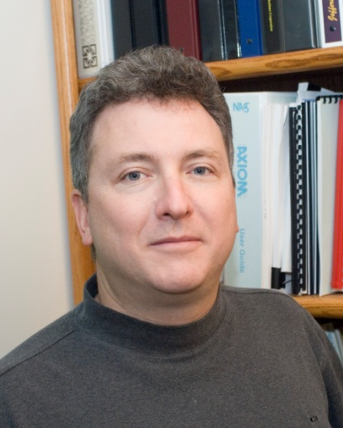
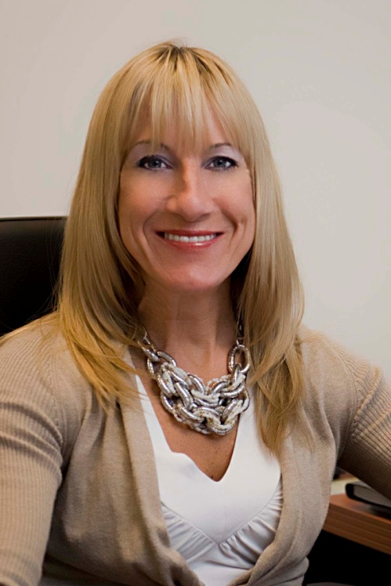
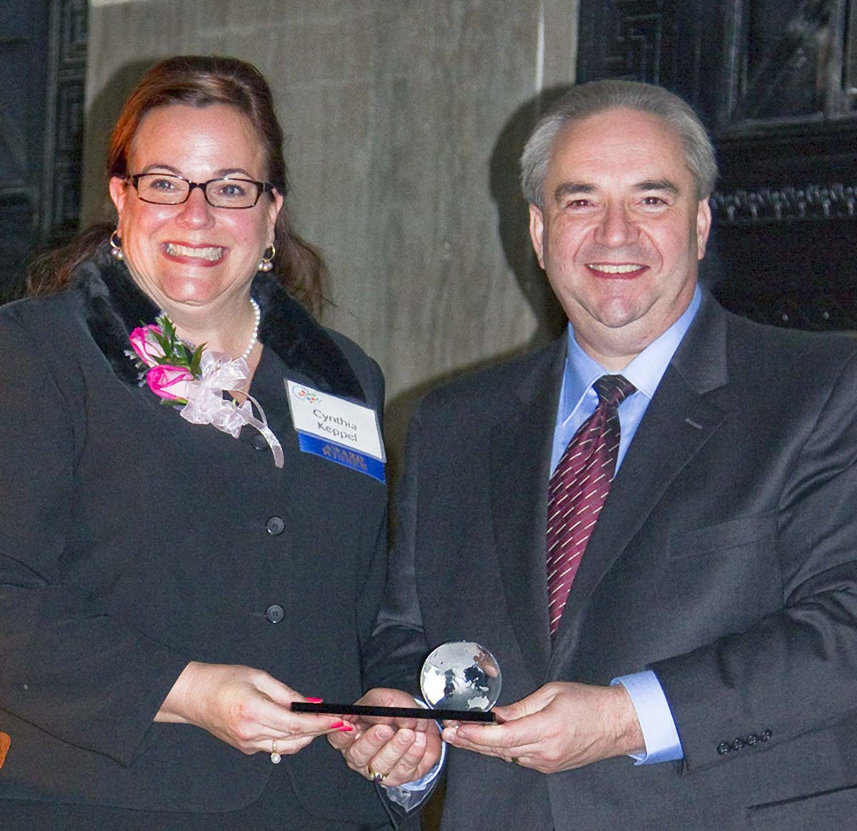
People
New Deputy Associate Director for Nuclear Physics
JLab Researchers Elected APS Fellows
Patrizia Rossi
Deputy Associate Director for Accelerators Elected Vice-Chair for APS Division of Physics Beams
Harut Avagyan
Rolf Ent
Robert Edwards
Fulvia Pilat
New Hall A Leader July 1, 2012
Cynthia Keppel

Slide 8
Jefferson Lab Organization
JSA Board of Directors
Chair
Diversity in
Leadership
Director
H. Montgomery
Deputy Director
Science & Tech
R. McKeown
Deputy Director
Operations and Chief Operating Officer
M. Dallas
Program Advisory Committee (PAC)
Human Resources
Internal Audit
Legal Counsel
Community Outreach, Science Education and Public Affairs
Experimental Physics
R. Ent
Theoretical & Computational Physics
M. Pennington
Free Electron
Laser
G. Neil
12 GeV Project Office
C. Rode
Chief Financial Officer & Business Srvs.
J. Scarcello
Environmental Safety, Health & Quality
M. Logue
Chief Information Officer/Chief
Technical Officer
R. Whitney
Facilities &
Logistics
J. Sprouse
Accelerator
A. Hutton
Engineering
W. Oren
Deputy:
P. Rossi
HALLS:
A: C. Keppel
B: V. Burkert
C: S. Wood
D: E. Chudakov
Deputy:
F. Pilat
Deputy:
D. Richards
Deputy:
G. Williams
Deputy:
A. Lung
APMs:
L. Harwood
R. Yasky
G. Young
Deputy:
L. Wells
Deputy:
R. May
Deputy:
C. Watson
Deputy:
T. Michalski

Slide 9
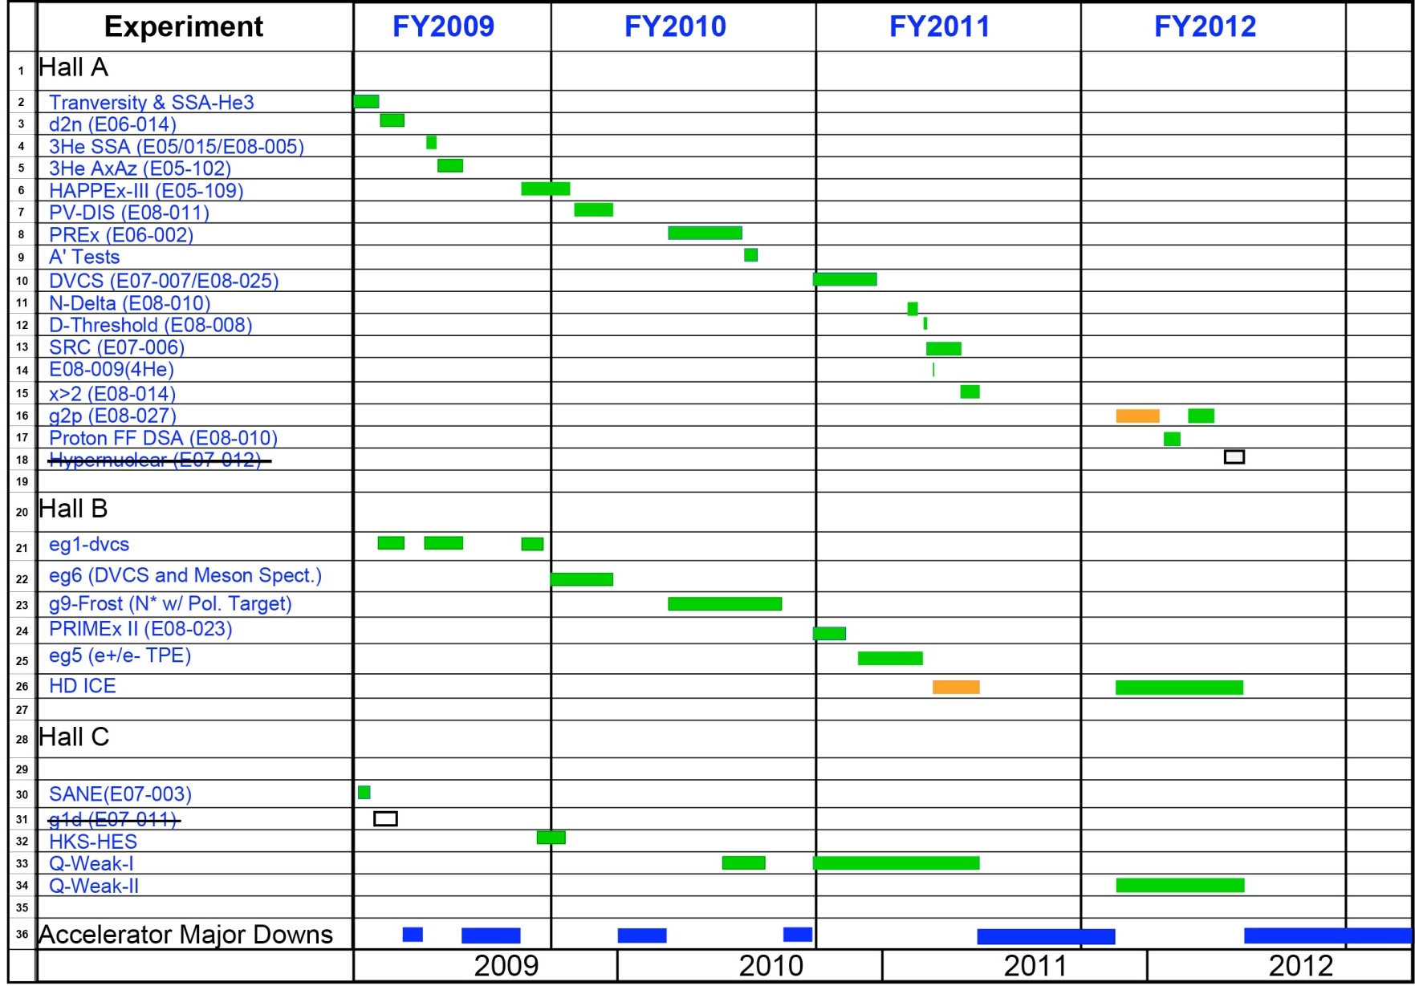
6 GeV Experimental Nuclear Physics Program (2009-12)
Successfully Completed!

Slide 10
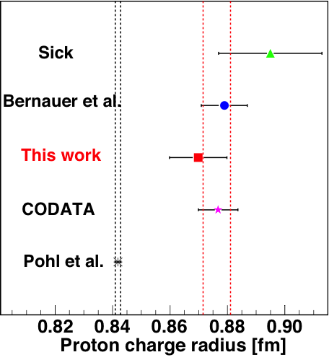
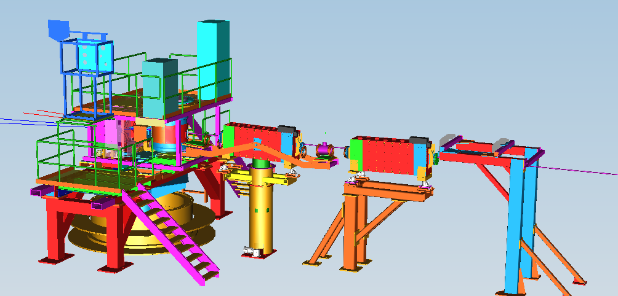
G2p/GEp: Major New Installation in Hall A
Strong Support from DOE/NP and User Contributions
Spin Polarizability : Major failure (>8σ) of χPT for neutron δ_{LT}. Need g₂ isospin separation to solve.
Hydrogen HyperFine Splitting : Lack of knowledge of g₂ at low Q² is one of the leading uncertainties.
Proton Charge Radius : one of the leading uncertainties in extraction of <R_{p}> from μ−H Lamb shift.
Septa
New Beam Diagnostics
(BPM,BCM,Harps,Tungsten Calo)
Chicane
Local Dump
Polarized Target
Major effort from JLab target group
to retrofit Hall B SC magnet after user magnet failed

Slide 11
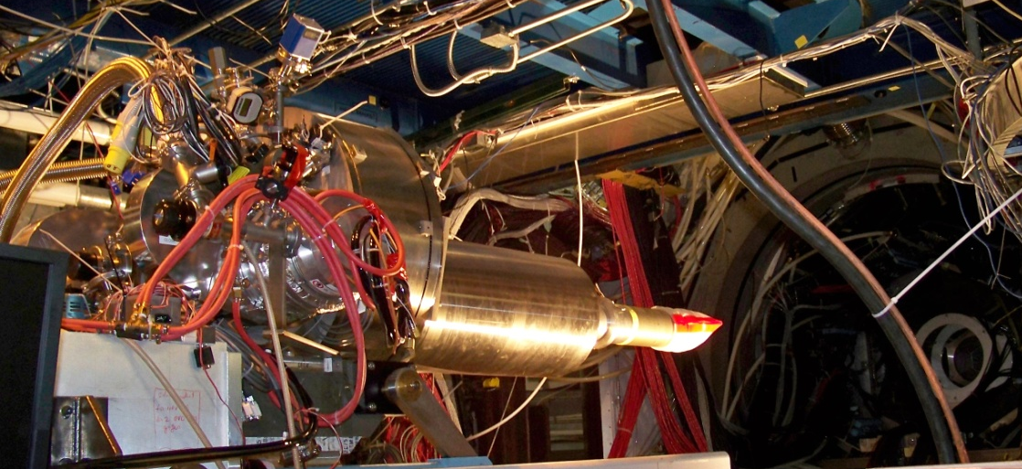
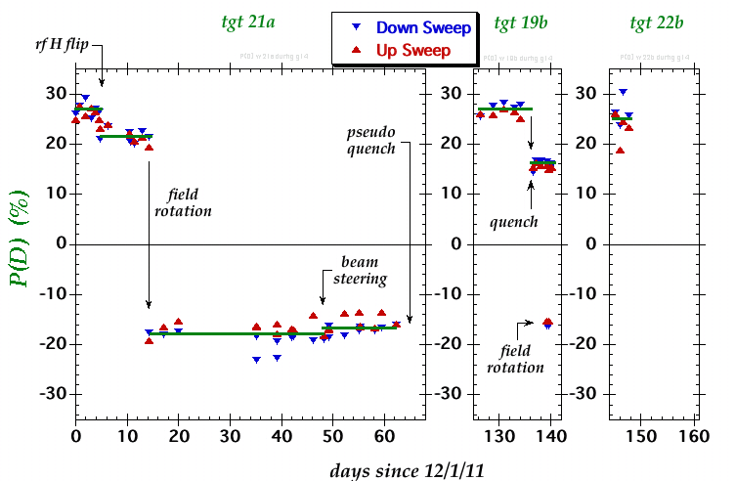
HDIce (g14, Hall B) Highlights
 | σ | Σ | T | P | E | F | G | H | T_{x} | T_{z} | L_{x} | L_{z} | O_{x} | O_{z} | C_{x} | C_{z}
pπ⁰ | ✔ | ✓ | ✓ |  | ✓ | ✓ | ✓ | ✓
nπ⁺ | ✔ | ✓ | ✓ |  | ✓ | ✓ | ✓ | ✓
pη | ✔ | ✓ | ✓ |  | ✓ | ✓ | ✓ | ✓
pη’ | ✔ | ✓ | ✓ |  | ✓ | ✓ | ✓ | ✓
pω | ✔ | ✓ | ✓ |  | ✓ | ✓ | ✓ | ✓
K⁺Λ | ✔ | ✓ | ✓ | ✔ | ✓ | ✓ | ✓ | ✓ | ✓ | ✓ | ✓ | ✓ | ✓ | ✓ | ✔ | ✔
K⁺Σ⁰ | ✔ | ✓ | ✓ | ✔ | ✓ | ✓ | ✓ | ✓ | ✓ | ✓ | ✓ | ✓ | ✓ | ✓ | ✔ | ✔
K^{0*}Σ⁺ | ✔ | ✓ |  |  |  |  |  |  |  |  | ✓ | ✓
pπ⁻ | ✔ | ✓ | ✓ |  | ✓ | ✓ | ✓ | ✓
pρ⁻ | ✓ | ✓ | ✓ |  | ✓ | ✓ | ✓ | ✓
K⁻Σ⁺ | ✓ | ✓ | ✓ |  | ✓ | ✓ | ✓ | ✓
K⁰Λ | ✓ | ✓ | ✓ | ✓ | ✓ | ✓ | ✓ | ✓ | ✓ | ✓ | ✓ | ✓ | ✓ | ✓ | ✓ | ✓
K⁰Σ⁰ | ✓ | ✓ | ✓ | ✓ | ✓ | ✓ | ✓ | ✓ | ✓ | ✓ | ✓ | ✓ | ✓ | ✓ | ✓ | ✓
K^{0*}Σ⁰ | ✓ | ✓
Proton targets
Neutron targets
✔ - HDIce

Slide 12
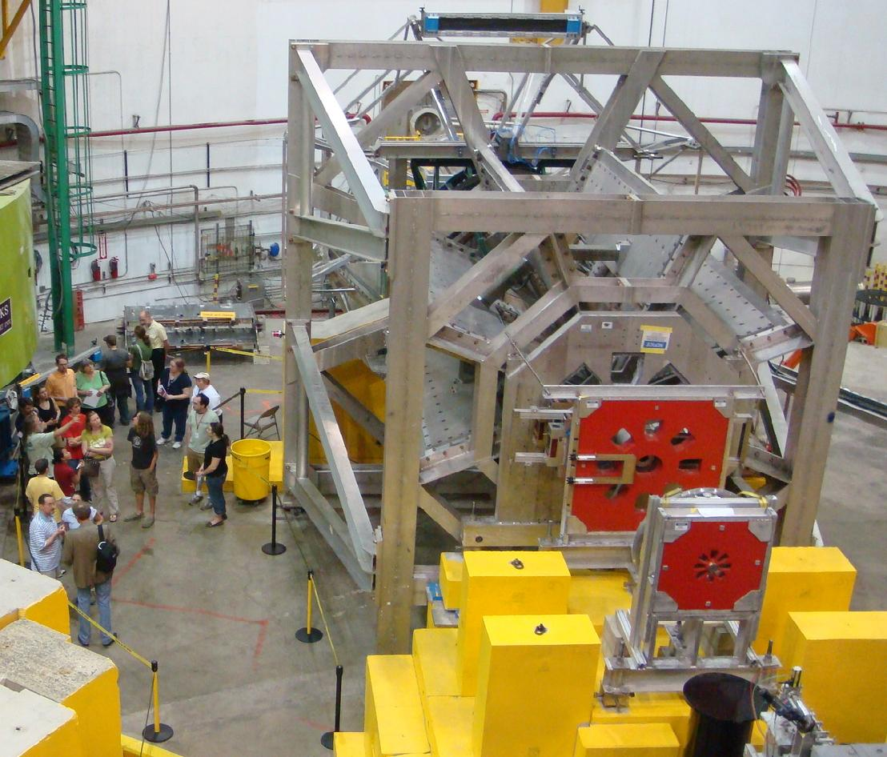
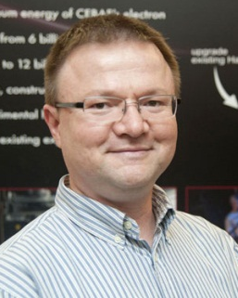
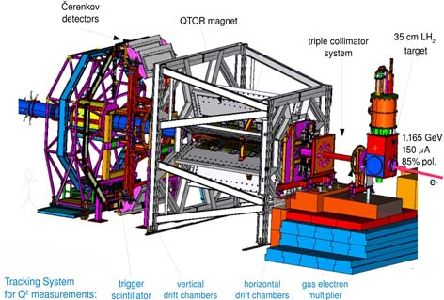
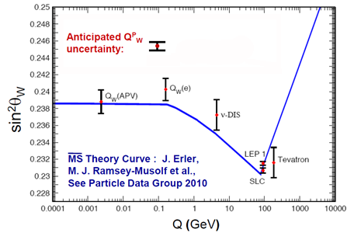
Qweak
Precise determination of
the weak charge of the proton
Q^{p}_{w} = (1 – 4 sin² θ_{W})
Silviu Covrig
DoE Early Career
Award 2012
lumi
monitors
lumi
monitors

Slide 13
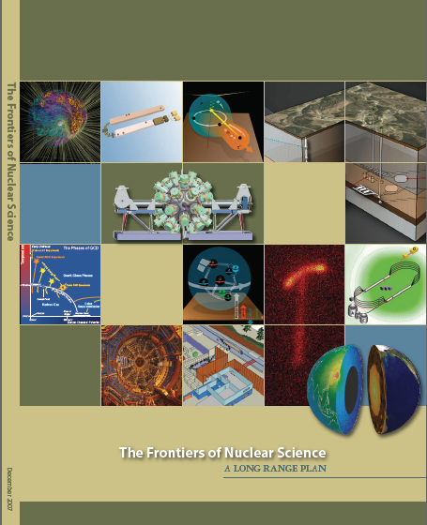
12 GeV Upgrade Project
Upgrade is designed to build on existing facility: vast majority of accelerator and experimental equipment have continued use
New Hall
Upgrade arc magnets
and supplies
Add 5 cryomodules
20 cryomodules
CHL upgrade
Maintain capability to deliver lower pass beam energies: 2.2, 4.4, 6.6….
Add arc
20 cryomodules
The completion of the 12 GeV Upgrade of CEBAF was ranked the highest priority in the 2007 NSAC Long Range Plan.
Add 5 cryomodules
Scope of the project includes:
Doubling the accelerator beam energy
New experimental Hall and beamline
Upgrades to existing Experimental Halls
Enhanced capabilities
in existing Halls

Slide 14
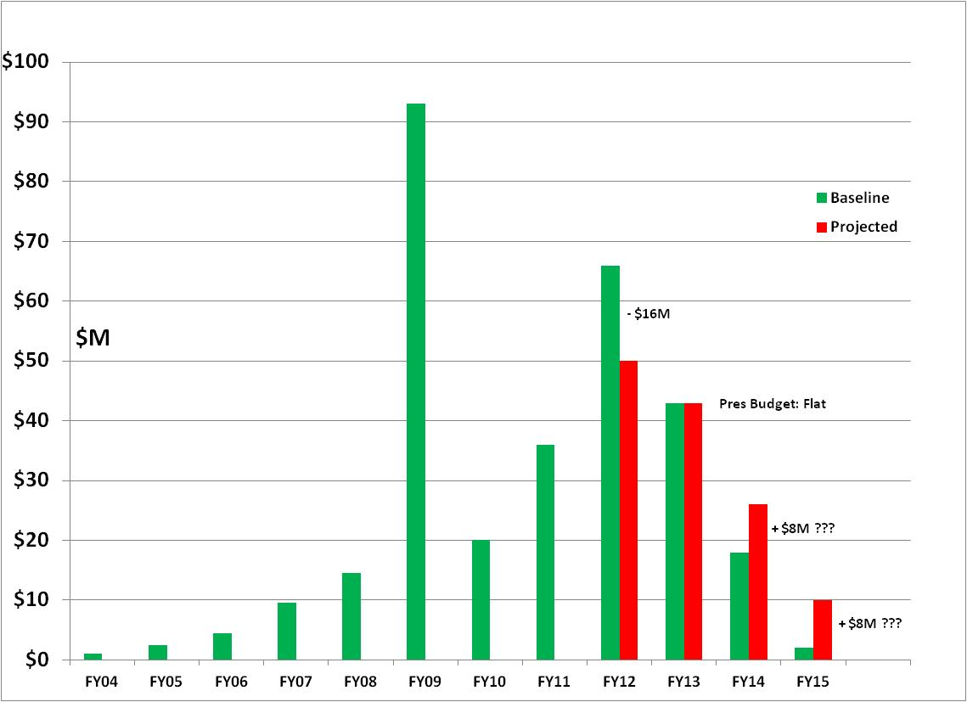
12 GeV - $310M TPC
FY12: reduction of $16M
FY13: Pres Request – no restoration
CD-4B may be at Risk
ARRA Shift of $65M
from FY10/11 to FY09

Slide 15
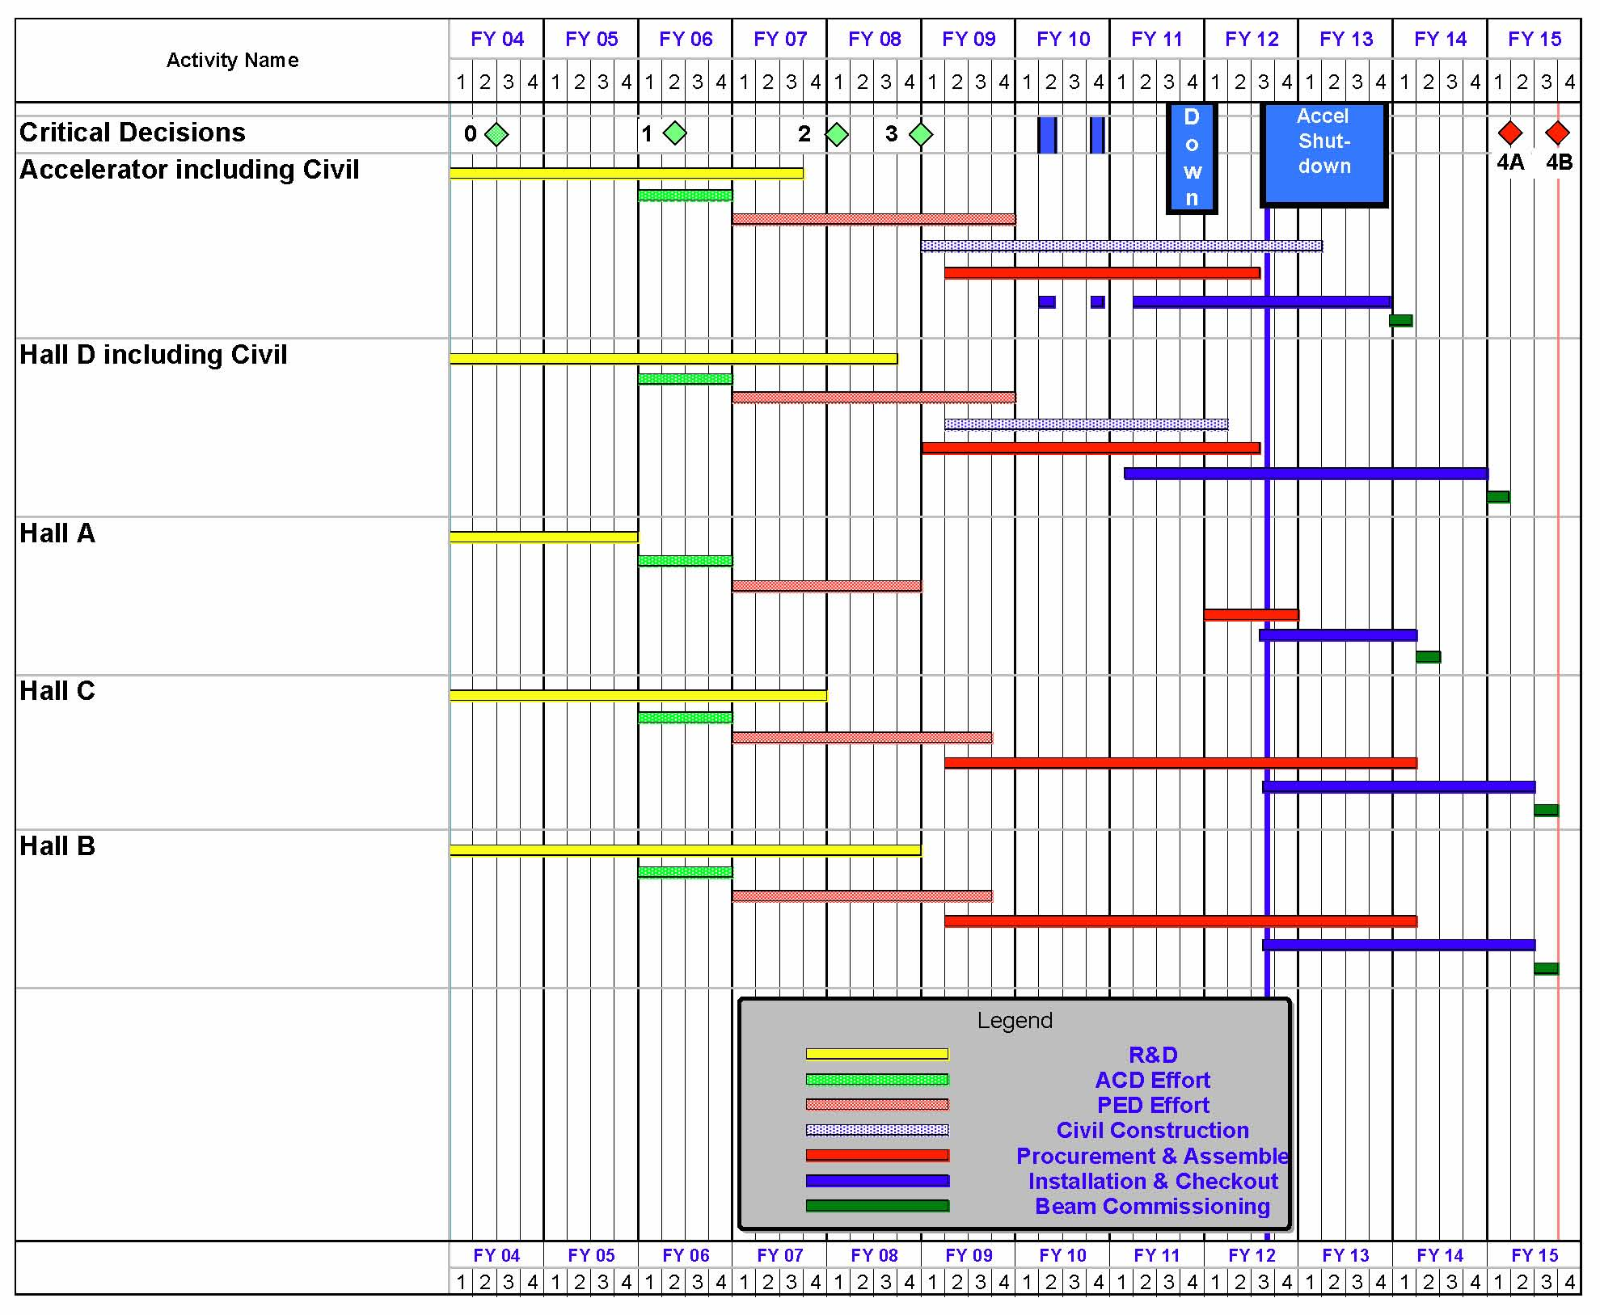
12 GeV Upgrade Project Schedule
FY12: reduction of $16M
FY13: Pres Request – no restoration
CD-4B may be at Risk
    12 16-month installation
    May 2012 - May Sept 2013
    Hall A commissioning start Oct 2013 Feb 2014
    Hall D commissioning start
    April 2014 Oct 2014
    Halls B & C commissioning start Oct 2014 Apr 2015
    Project Completion June 2015
Next DOE Project Review
June 21, 2012

Slide 16
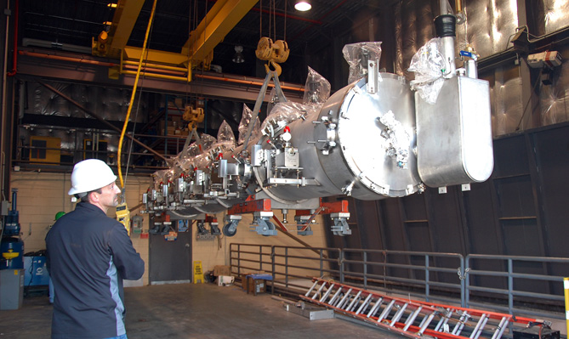
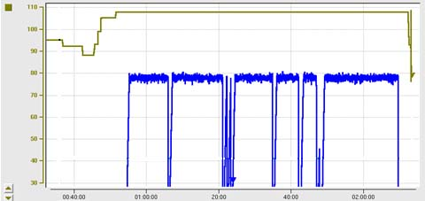
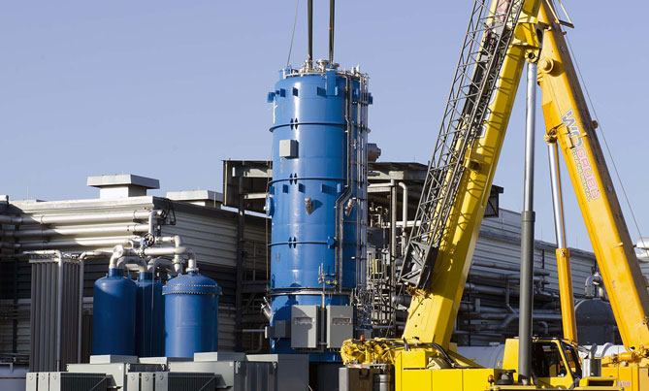
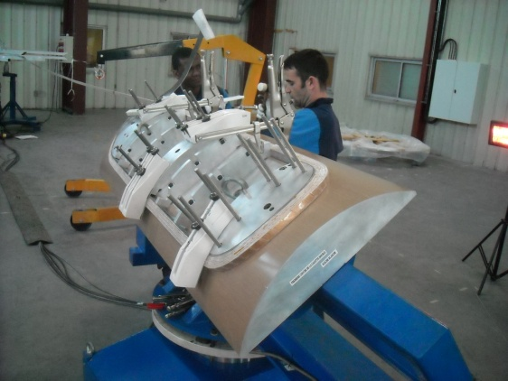
12 GeV Upgrade – Recent Progress
High gradient cryomodule performance
demonstrated in tunnel
◻ Met research beam spec. of 108 MeV @ 465 μA
Central Helium Liquefier-2 equipment in place
Hall D – equipment installation in progress
Superconducting magnets under construction
All major detector systems under construction
Third C100 Cryomodule
transferred to tunnel
C100 Cryomodule Energy Gain – May 18th
108 MeV
– 200
98 MeV
CHL-2
installation
– 150
ENERGY GAIN (MeV)
Beam Current/pass (μA)
– 100
– 50
TIME (in 20 minute increments)
Hall C Dipole
Magnet Coil

Slide 17
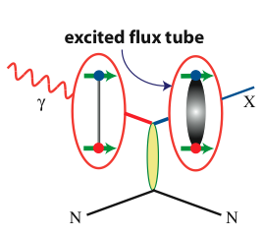
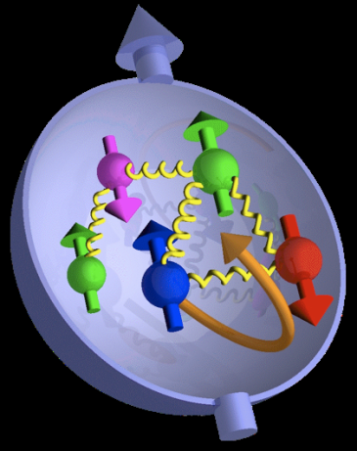
21st Century Science Questions
What is the role of gluonic excitations in the spectroscopy of light mesons?
Where is the missing spin in the nucleon?
Role of orbital angular momentum?
Can we reveal a novel landscape of nucleon substructure through measurements of new multidimensional distribution functions?
Can we discover evidence for physics
beyond the standard model
of particle physics?

Slide 18
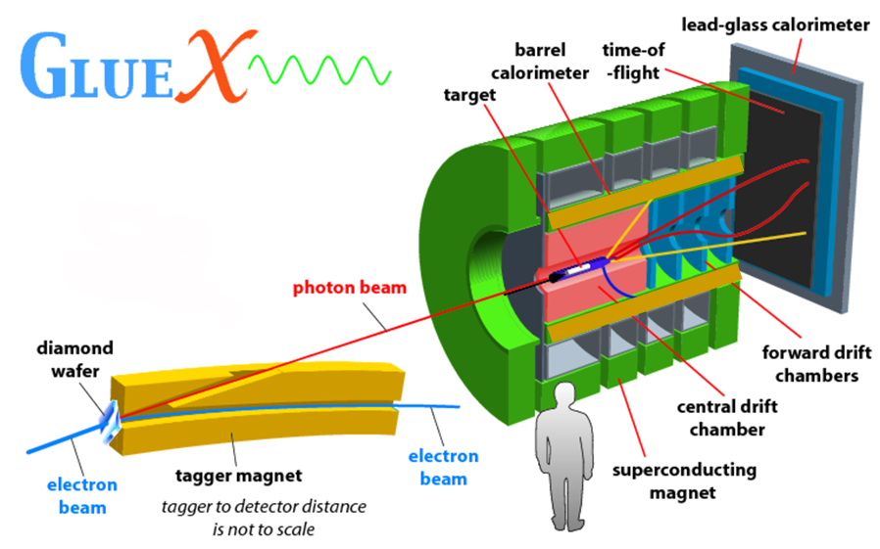
Hall D
FCAL
TOF
BCAL
start counter
FDC
CDC
BCAL

Slide 19
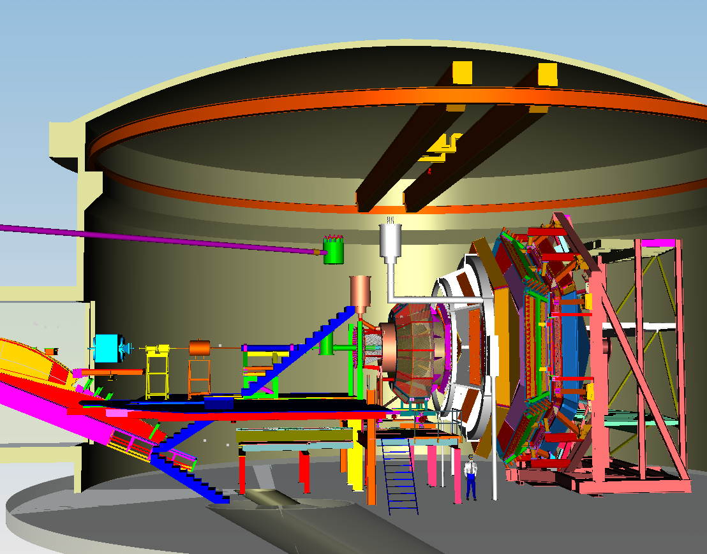
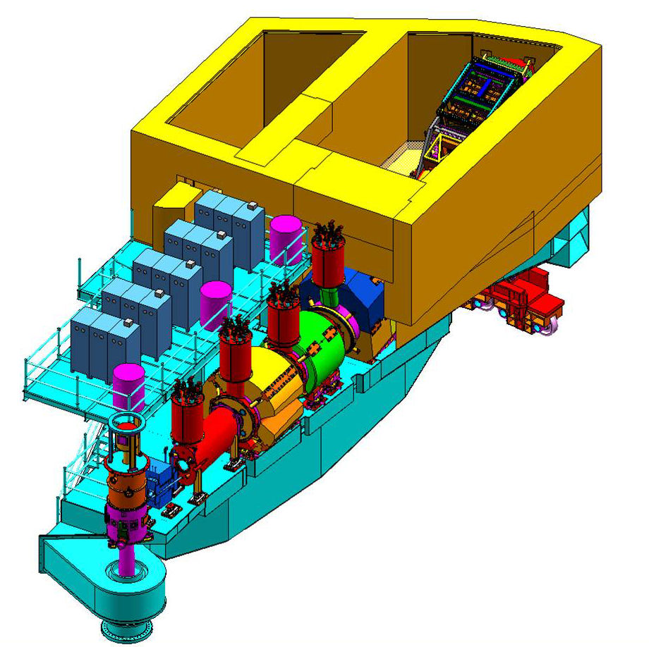
Hall C
SHMS = “Super High Momentum Spectrometer”
Halls B and C
Hall B
CLAS12 = CEBAF Large Acceptance Spectrometer
Key Features:
  1 torus & 1 solenoid magnet
new detectors: Cerenkovs, calorimeters, drift chambers, silicon vertex tracker
  -- re-use some existing detectors
hermetic device, low beam current, high luminosity
Key Features:
  3 quadrupole & 1 dipole & 1 horizontal bend magnet
new 6 element detector package
  complementary to existing spectrometer (HMS)
rigid support structure
well-shielded detector enclosure

Slide 20
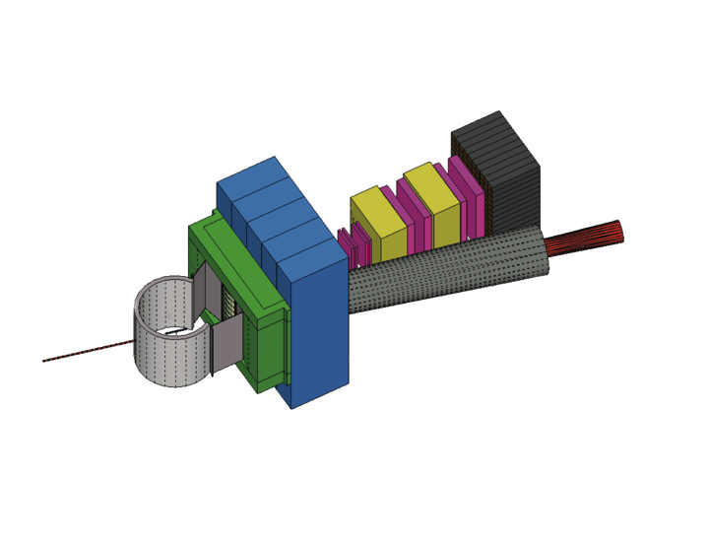
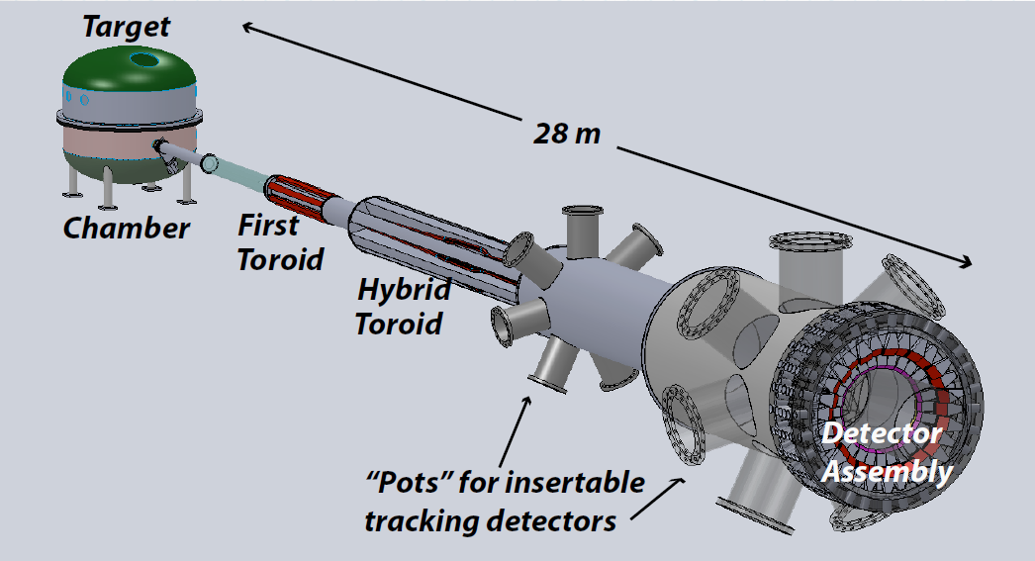

Hall A – New Instrumentation
Super BigBite Spectrometer
Extend form factors
TMD studies
MOLLER experiment
PV e-e scattering
Precise standard model test
SoLID
PV e-quark scattering
High precision TMD studies
TMD = Transverse Momentum Dependence
PV = Parity Violating

Slide 21
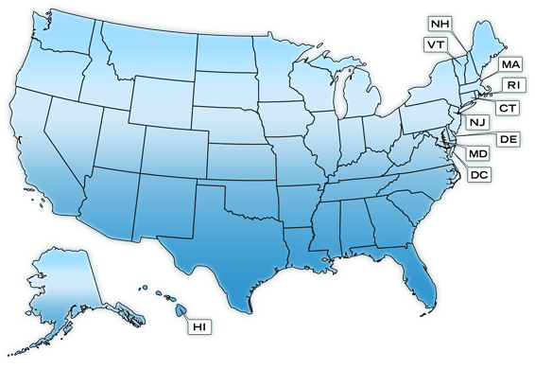
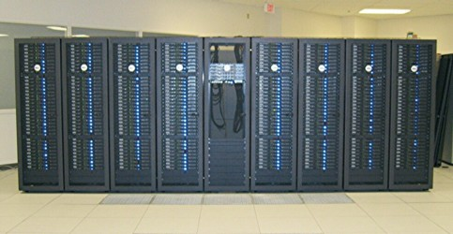
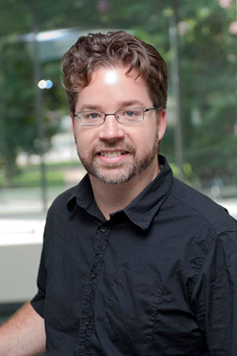
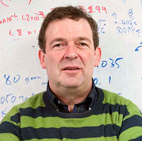
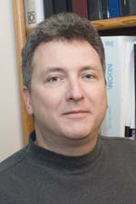

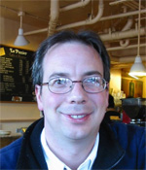

Jefferson Lab Lattice QCD
USQCD
Infrastructure
Executive
Committee
Member
Chroma
Clusters & GPUs
Dru Renner
Program
Committee
Chair
Ken Wilson Lattice Award 2011
ARRA & NP
Facilities Project
Chair, Users
Community
ORNL
Domain specific language
Optimize codes for leadership
& accelerated architectures
Implement multi-grid & domain
decomposed inverters
Prepare for new technologies

Slide 22







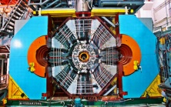
Jefferson Lab Physics Analysis Center
Definitive physics from high quality data demands precision analysis tools
hadron spectrum
GPDs, TMDs
Experiment
QCD
Pool world theoretical/phenomenological expertise
SAID
Bonn-
Gatchina
EBAC
Common, robust methodologies, especially in Amplitude Analysis
MAID
Train generation of experimentalists and theorists
global networking
to be led by Jefferson Lab
BESIII

Slide 23
Jefferson Lab Electron Ion Collider
Activity Name | 2010 | 2011 | 2012 | 2013 | 2014 | 2015 | 2016 | 2017 | 2018 | 2019 | 2020 | 2021 | 2022 | 2023 | 2024 | 2025
12 GeV Upgrade
FRIB
EIC Physics Case
NSAC LRP
EIC CD0
EIC Machine Design/R&D
EIC CD1/Downsel
EIC CD2/CD3
EIC Construction
Initial configuration (MEIC):
  3-11 GeV on 20-100 GeV ep/eA collider
  fully-polarized, longitudinal and transverse
  luminosity: up to few x 10³⁴ e-nucleons cm⁻² s⁻¹
  Design Maturing
  User Driven Physics Case
  Integrated Detector
  Cost Estimate in progress

Slide 24
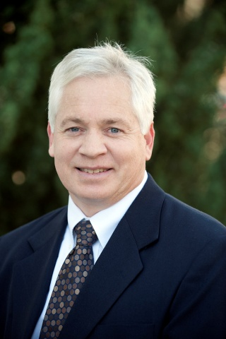
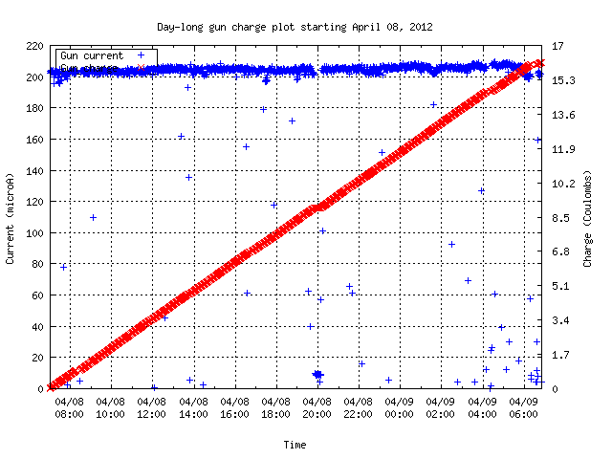

Polarized Electron Source
B. Matthew Poelker
2011 E. O. Lawrence Award
Beam Current
Charge from photogun
Electron Gun Requirements
Ultrahigh vacuum
No field emission
Maintenance-free
24 Hours
Record Performance (2012): 180 μA at 89% polarization

Slide 25
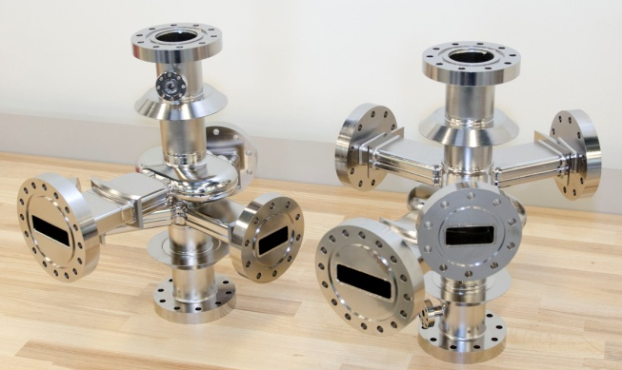
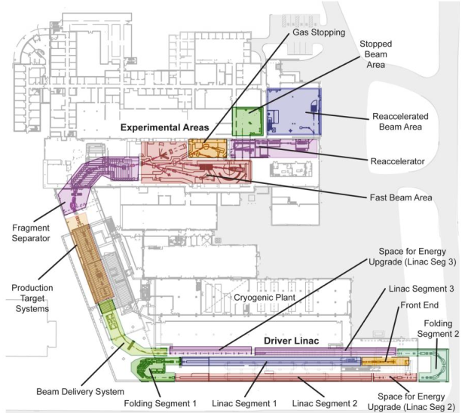
Superconducting RF Technology
12 GeV CEBAF Upgrade – 84 cavities
  All processed, most exceed 30 MV/m
  Cryomodule assembly ~70% complete
FRIB:
– Committed to do processing of all half-wave cavities
– In discussion re full cryomodule design, assembly, and testing
APS - construct crab cavity prototype
Project X - designed, constructed and tested new 650 MHz cavity shape to minimize multipacting
Next Generation Light Source - collaboration w/LBNL, FNAL, SLAC
ILC - leading gradient improvement effort
BES inverse compton scattering source – developing technology
European Spallation Source – in negotiations re spoke cavity R&D
7-cell cavity
Crab cavity prototype for APS
FRIB Layout

Slide 26
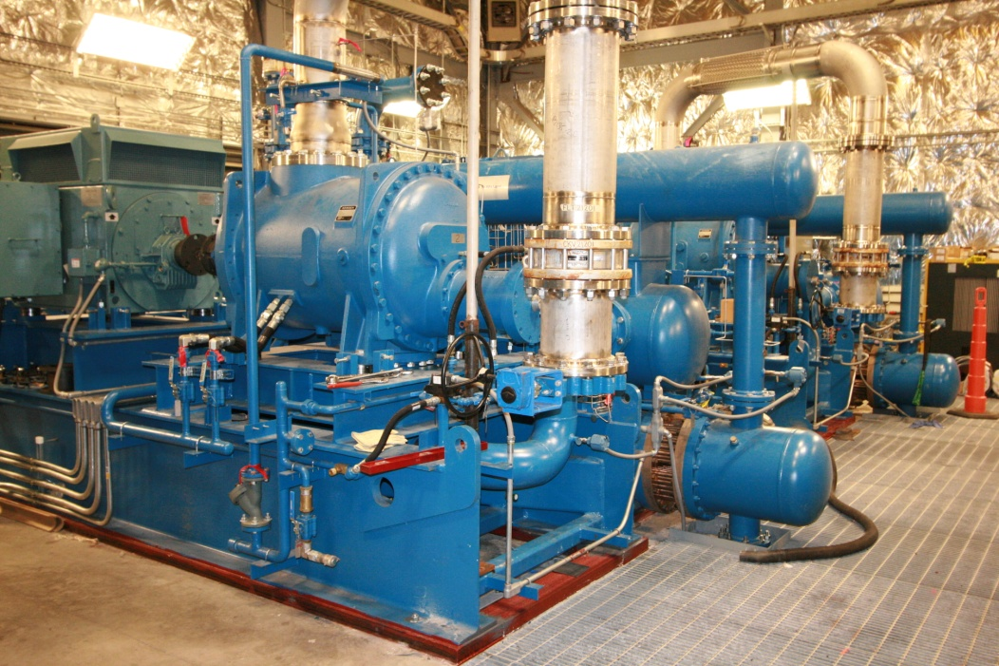
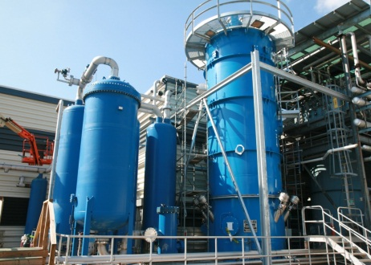
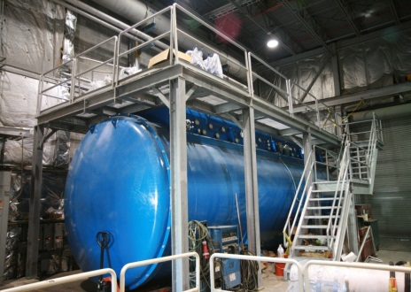
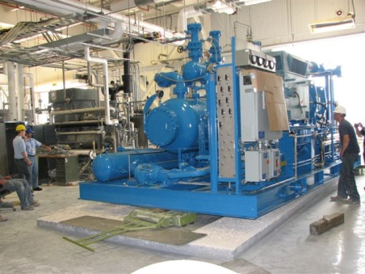
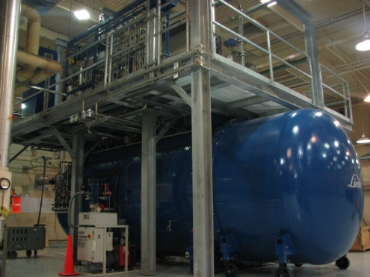
Cryogenics Projects
12 GeV Upgrade
  Doubles capacity of CHL
James Webb Telescope, NASA
  Improvements to the
  refrigeration plant to test
  components
FRIB
  Provide design and
  construction support
Next Generation Light Source
  Provide design and
  construction support
12 GeV Upper Coldbox
New CHL 12 GeV Compressors
12 GeV Lower Coldbox
Helium refrigerator system
for James Webb telescope testing

Slide 27

Free Electron Laser
Non-DOE Customers:
  US Department of Defense: ONR, JTO, USAF
Synergistic with TJNAF mission
  DarkLight experiment (A’ search)
  Development of improved Kr dating capability (ground water, arctic ice)
Free Electron Laser

Slide 28


NSAC 2007 LRP Implementation

Slide 29
NSAC-2007-LRP Implementation Subcom
Nuclear Community Members
Joseph Carlson, Brad Fillipone, Stuart Freedman, Haiyan Gao, Donald Geesaman (ex officio, NSAC Chair), Barbara Jacak, Peter Jacobs, David Kaplan, Kirby Kemper, Krishna Kumar, Naomi Makins, Curtis Meyer, James Nagle, Witold Nazarewicz, Krishna Rajagopol, Michael Ramsey-Musolf, Lee Sobotka, Robert Tribble (Chair), Michael Wiescher, John Wilkerson
Members from Broader Scientific Community
Adam Burrows, George Crabtree

Slide 30

12 GeV Science
phenomenology
techniques (theory+exp)
standard model tests
Discovery
Potential
New
Defining the Science Program:
  Highest priority in 2007 NSAC Long Range Plan
  Seven Reviews: JLab Program Advisory Committees (PAC) 2006 through 2011
  Results: 48 experiments approved ; 7 conditionally approved
  PAC39 scheduled June 2012
  White paper for 2012 NSAC subcommittee (in progress)
Experiments for 4 Halls approved for more than
five years of operation beginning in FY15
Notes:
Like to give an overview of Jefferson Lab.
I can’t get going without saying something of the current status of the lab.
The dominant part of the talk will concern our 12 GeV Upgrade Project, the physics and the project status.
However, the technology which enables our nuclear physics and its enhancement also provides opportunities in the future
Photon Science
Accelerator Driven Systems
Nuclear Physics
Conclude

Slide 31
“White Paper”
Physics Opportunities with the
12 GeV Upgrade at Jefferson Lab
Preparation for 2012 NSAC activity
Update physics case for “NSAC audience”
Overview (3) – Pennington/Ent/BMcK
Meson Spectroscopy and Structure (5) – Meyer, Dudek
Nucleon Structure and Spectroscopy (10) – Meziani, Richards
QCD and Nuclei (5) – Weinstein, Miller
The Standard Model and Beyond (5) – Kumar, Essig
Appendix A: Experimental Equipment (10) – Young

Slide 32
A Laboratory for Nuclear Science
The Jefferson Lab electron accelerator is a unique world-leading facility for nuclear physics research and related applications
12 GeV Upgrade ensures at least a decade of excellent opportunities for discovery
– New vistas in QCD
– Growing program Beyond the Standard Model
EIC moving forward:
– Strong science case, much builds on JLab 12 GeV program
– MEIC design well developed – time scale following 12 GeV program is “natural”
Accelerator Science and Technology
– JLab: CEBAF and FEL
– SRF development
– Support for DOE-SC (and other) projects

Slide 33







Jefferson Lab Open House – May 19, 2012

Slide 34
Back-ups

Slide 35

SRF Cavity Development
Lower cost Niobium due to fewer purification and preparation steps
World Record Q₀
4.6x10¹⁰ @ 20 MV/m
World Record Q₀
4.6x10¹⁰ @ 20 MV/m

